Slide 1
Self-Service Banner (SSB) Instructions for PCard
Notes:
Notes:

Slide 2
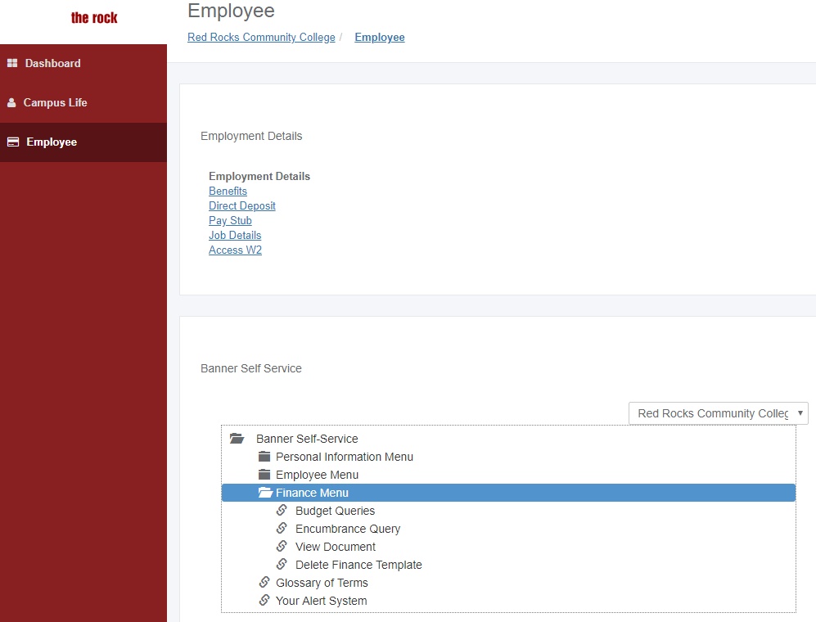
Log into The Rock
Click on the Employee tab
Click the Finance Menu under Banner Self Service
Click on Budget Queries

Slide 3
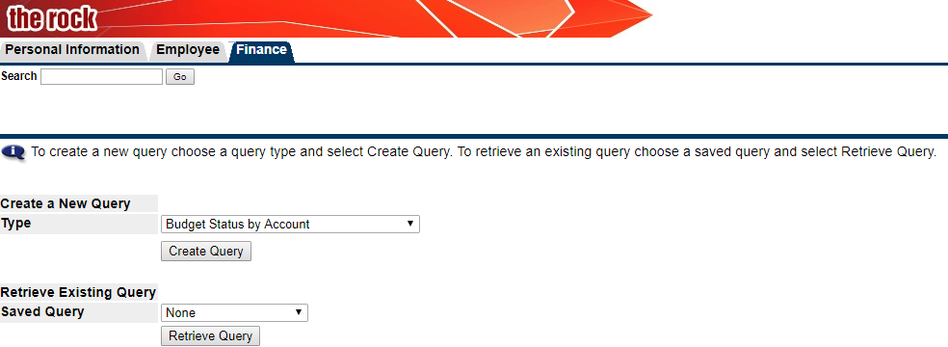
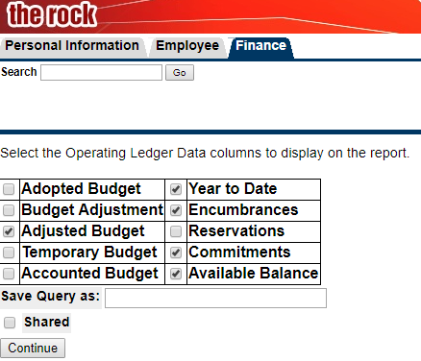
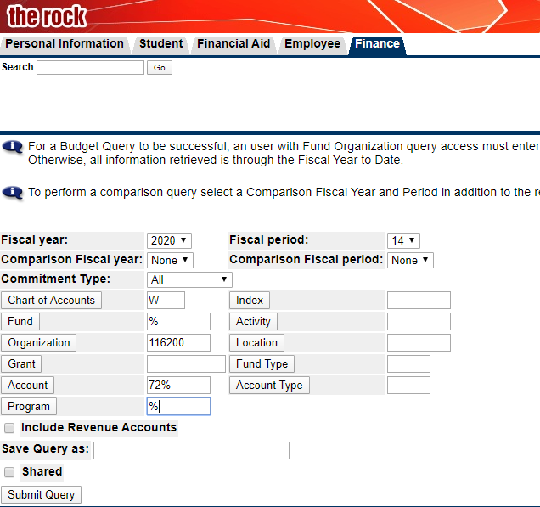
How to perform a query in Self-Service Banner
To create a new query, select
Budget Status by Account in the drop down menu and click Create Query.
Select the data you want to view.
Common choices are to view Adjusted Budget, Year to Date, Encumbrances/Commitments and Available Balance.
Click Continue.
Select the fiscal year you want to view. To view the entire year, set Fiscal period to 14.
Enter the ORG number and Account that you wish to view.
Populate Fund and Program fields with a percent sign % “wildcard” to capture all data. Can use the 72% to see all operating Account codes. Click Submit Query.
You can also specify the account code (ie. 720840 misc.) to locate transactions that were not reallocated.

Slide 4
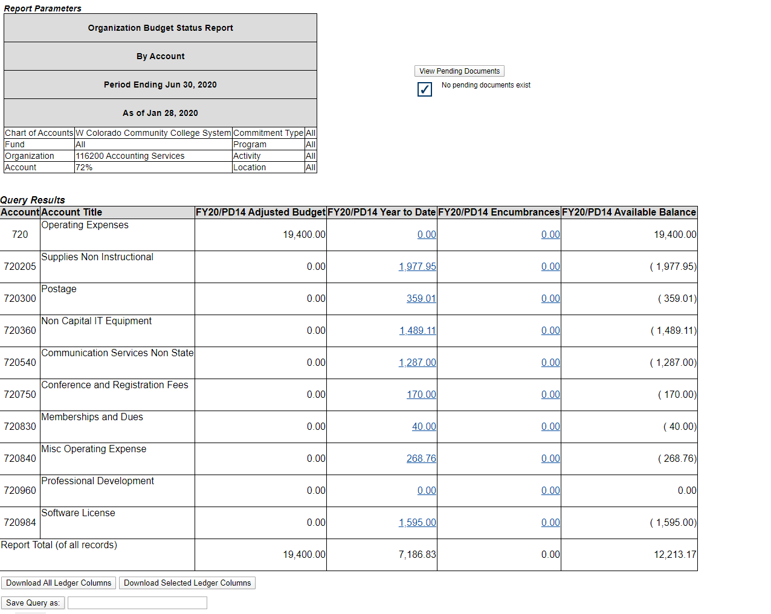
Research Expense Detail
The results of your query are displayed.
To see detail on an account line, click the hyperlinked number in the YTD column for the account code that the transaction was reallocated to.

Slide 5
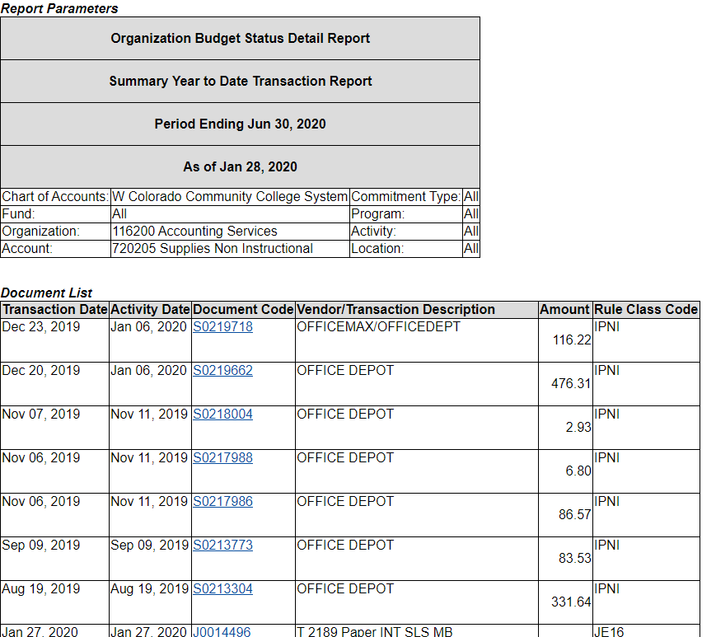
Account Code Detail
This page will display all the transactions that have been applied to the specific account code (ie. Supplies.
You can drill down to the specific transaction that you need by clicking on the hyperlink.
To access more transactions, click on the
Next 15 icon- located at the bottom of the page.
This page can also be used as back-up to support the IDI.
The “IPNI” Rule Code indicates it is a PCard purchase.

Slide 6
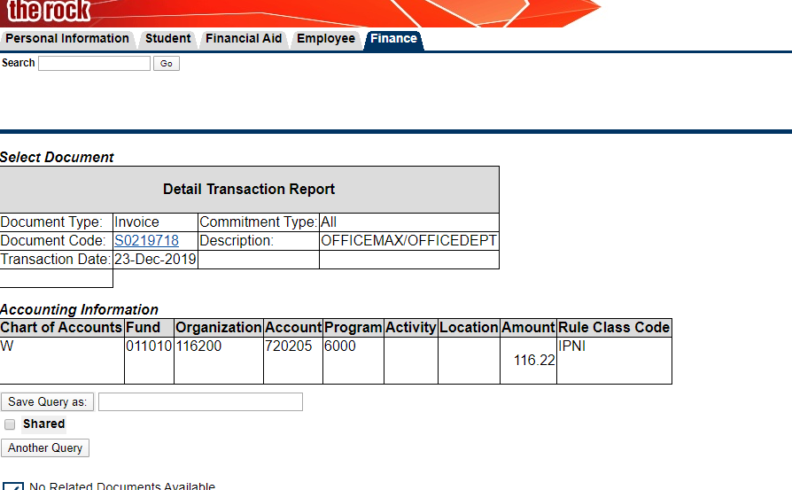
The results are displayed here.
*This is the page that you will print (Control “P”) and submit with your PCard statement if you marked SSB on the Transaction Header Sheer.*
The intent is to show what account code the transaction was applied to.
You can also use this page as back-up for the IDI.
To perform another query, click Another Query.
Screen Shot for PCard Statement

