Slide 1
Integrative Nursing Pathway: INP
Red rocks community college to CU College of Nursing

Slide 2
Nursing as a career
Helping professional
Critical thinking
Patient advocate and team player
Technical Skills

Slide 3
ANA BSN 80/2020
American Nursing Association initiative to have 80 percent of hospital nurses with Bachelor of Science degrees by 2020.

Slide 4
www.onetonline.org
Yearly Salary Colorado compared to U.S. average

Slide 5
Projected Annual Job Openings refers to the average annual job openings due to growth and net replacement.
United States | Employment |  | Percent Change | Projected Annual Job Openings ¹
 | 2014 | 2024
Registered Nurses | 2,751,000 | 3,190,300 | +16% | 108,840
Colorado | Employment |  | Percent Change | Projected Annual Job Openings ¹
 | 2014 | 2024
Registered Nurses | 44,840 | 59,660 | +33% | 2,350

Slide 6
INP Program Overview
RRCC & CU Nursing partnership
Cohort model
First year at RRCC than transition to CU

Slide 7
Exclusions
Previous Bachelor’s or Master’s degree
RN or LPN licensure
What is OK?
Nursing Assistant, Medical Assistant, Phlebotomist and any Associate Degree

Slide 8
Prerequisites (ten year window)
ENG 121, College Composition I (this class can be over ten years old)
BIO 111, General College Biology
CHE 101, Intro to Chemistry
MAT 135, Intro to Statistics
MAT 121, College Algebra (or higher)
PSY 101, General Psychology I
SOC 101, Intro to Sociology
HWE 100, Human Nutrition
One GTAH1 or GTAH2 course (GTAH=Guaranteed Transfer Arts & Humanities)

Slide 9
Starting January 2019 application period
Additional Prerequisite:
COM 220, Intercultural Communications

Slide 10
G.P.A.
3.0 for all prerequisite course work and taken within ten years of time of applying to INP program. English Composition can be over ten years old.
C or better for all prerequisites (plan for A’s and B’s)
Preference for 3.0 G.P.A. for all coursework taken as well.

Slide 11
What not to take
Courses that are part of first year of program
ENG 122, College Composition II
BIO 201, A & P I
BIO 202, A & P II
BIO 204, Microbiology
PSY 235, Human Growth and Development
HIS 247, Contemporary World History
ANT 250, Medical Anthropology

Slide 12
AP/CLEP/IB
Guidelines for the transfer of accelerated credit (the College of Nursing may have different standards than Red Rocks CC or other CU campuses)
AP (Variable) and CLEP (54 score or higher) guides may be found through the link below; please contact the College of Nursing for questions about IB credits
http://www.ucdenver.edu/academics/colleges/nursing/Documents/renamed/ap-credit-transfer-guide.pdf
ENG 121, MAT 121, PSY 101 and SOC 101 can be CLEP’ed with score of at least 54
http://www.ucdenver.edu/academics/colleges/nursing/Documents/PDF/CON_CLEP_Credit_Transfer_Guide.pdf

Slide 13
Strategies to be a competitive candidate
A’s and B’s in science prerequisites (BIO 111 & CHE 101)
Take your prerequisites at a Colorado Community College.
Keep your G.P.A. at 3.0 or higher for all prerequisites.
Develop your writing skills.
Practice interpersonal communication skills.
Practice interviewing skills.

Slide 14
Other considerations
Prerequisites completed at a Colorado Community College
In state residency at time of application

Slide 15
Application Process
Apply January 1st through March 31 (apply early)
Nursing CAS: www.nursingcas.org
$45 application fee
Personal statement
Two letters of reference (one academic)
Resume
Criminal disclosure question

Slide 16
INTERVIEW
Practice Interview Skills
Mock Interview: Utilize Career Services
Group activity

Slide 17
Personal Statement
Develop your writing skills
Essay structure
Utilize Writing Center

Slide 18
Language requirement
Importance of strong verbal and written communication skills
Who needs TOEFL/IELTS?
Minimum scores

Slide 19
First year of program – at RRCC
Fall Semester
BIO 201, Human Anatomy & Physiology I
BIO 204, Microbiology
ENG 122, English Composition II
PHI 112, Ethics
Spring Semester
BIO 202, Human Anatomy & Physiology II
ANT 250, Medical Anthropology
PSY 235, Human Growth and Development
HIS 247, Contemporary World History
HRP 219, Pathway to Professional Nursing II

Slide 20
End of First Year
Graduate from Red Rocks with Associate of Science (AS) degree
Transition to Anschutz Medical Campus
Must maintain a minimum 3.0 cumulative G.P.A. in order to transition

Slide 21
Costs of program
At Red Rocks
$9887 Tuition & Fees(with COF) – at 2017-18 costs (includes 10 prerequisite courses) = 62 credits
Books for 19 courses at estimated $200 per course = $3800
Total at RRCC at current rates = $13,687
At CU
$32,000 (roughly which includes fees, books and supplies for six semester) – at current prices. Does not include health insurance.
Total: $45,687 at current prices

Slide 22
Transition to Cu CON
Block Scheduling
Cohort: 135 students at Anschutz Medical Campus
Clinical Education

Slide 23
Transition to CU CON - continued
Clinical Groupings and Skills Labs
Clinical Education Settings
Clinical Compliance
Senior Practicum

Slide 24
Transition to CU Con - continued
Program Expectations
Working While in the Program
Leave of Absence

Slide 25
What if I’m not accepted?
Apply to UC CON Traditional Program
MSUD
Regis
FRCC or ACC
DORA List of approved Nursing programs:
https://drive.google.com/file/d/0B-K5DhxXxJZbM3NHdHh3Q1ZHUWs/view?pli=1

Slide 26
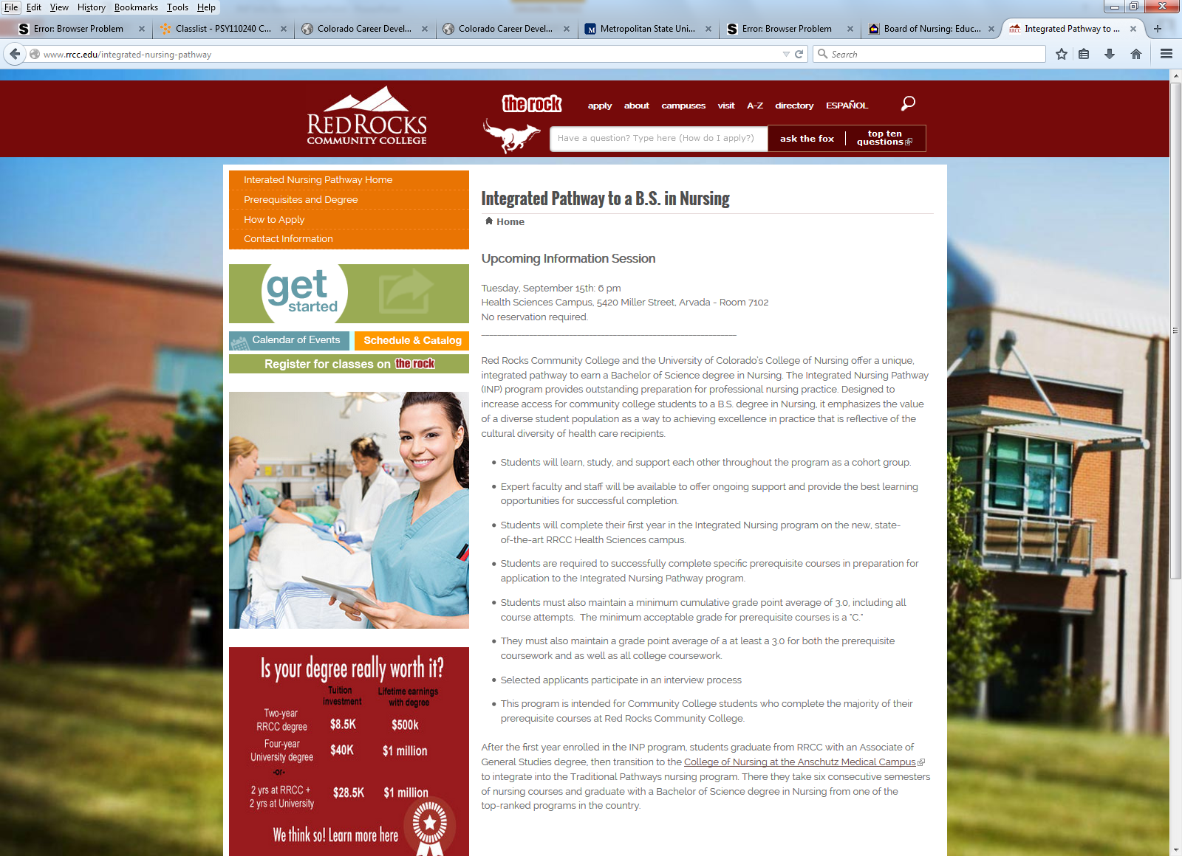
Check our website
www.rrcc.edu/integrative-nursing-pathway
http://www.ucdenver.edu/academics/colleges/nursing/programs-admissions/bachelors-programs/Pages/IntegratedNursingPathway.aspx
For updates and revisions
FAQ’s

Slide 27
First RRCC INP cohort (and others)

Slide 28
2017-18 cohort

Slide 29
Contact info
Carmen Stephens, DNP, RN: Nursing Faculty – 303-914-6081
Carmen.Stephens@rrcc.edu
Dan Macy: INP Advisor – 303-914-6016 dan.macy@rrcc.edu
Amy Sturrock, INP CU CON Advisor – 303-724-1485 amy.sturrock@ucdenver.edu

Slide 30
Questions ?

Slide 31
Thank You !

