Slide 1
Scaffolding Research Writing
RRCC Writing Across the Curriculum Workshop
www.rrcc.edu/writing-across-curriculum
Presented by Kevin Kelley and Rebecca Smith

Slide 2
Consider
What concerns do you have about your students’ research writing?
How do your students struggle with research writing?
Choose one of the questions above and freewrite for two minutes.

Slide 3
Potential Purposes
What’s the purpose of the assignment?
Learn information or knowledge
Develop critical thinking
Engage in the genres of a discipline
Service or professional application
Develop writing and communication skills

Slide 5
Audience Possibilities
Private(ish):
You
Classmates
Themselves
Public:
Academic: Scholars or practitioners
Professional: Clients, patients, organizational members, donors...
Targeted public audience

Slide 6
Research writing may include...
Original Research: Student performs and writes about—
Experiments, observations, interviews, surveys, or original analysis (Meta, Critical, Statistical, Mathematical, Lab-based).

Slide 7
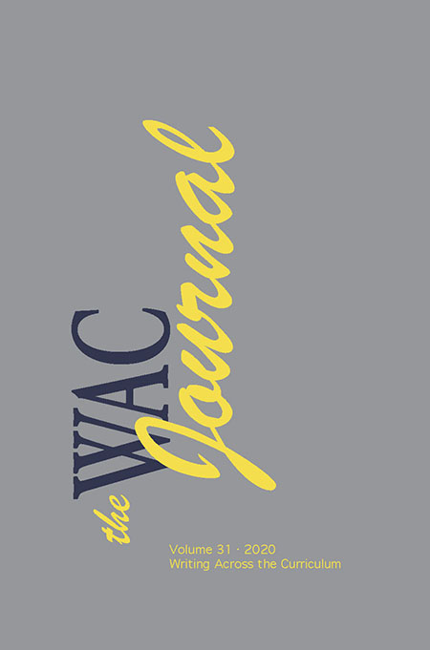
Research Writing may include...
Primary Research: Student writes about—
Original documents such as diaries, speeches, manuscripts, letters, interviews, records, eyewitness accounts, autobiographies.
Scholarly works such as academic journal articles, clinical reports, or case studies.
Creative works such as literature, music, video, and photography
News (reportage), organization, and industry reports

Slide 8
Research Writing may include...
Secondary Research: Student writes about—
Works that write about or comment on other works.
Encyclopedias (Wiki), Reviews, Textbooks, and Handbooks
Tertiary Sources
Abstracts, Indexes, Catalogs

Slide 9
Scaffolding
Scaffolding is the process of breaking down an assignment into manageable steps that build on each other.
Scaffolding supports students as they develop new knowledge over time.
Scaffolding is an equity and inclusion practice because it is meant to “build everyone from the ground up.”

Slide 10
Scaffolding a Research Project
Introduce the assignment
Provide and review examples in whole or part so students can be familiar with the genre style and expectations.
Help students develop a research topic and (if applicable) a research method
Review sources that could be used such as academic articles, popular journals, websites, and other primary or secondary sources.
Guide students to where appropriate sources are located such as library database, Google Scholar, etc.
Review how to read and annotate appropriate sources. This step may include the writing of a literature review, annotated bibliography, close read, or other reflective/analytical essays in preparation for the main assignment.
Understand how to use sources effectively and ethically: quotation, paraphrase, summary, and citation. May review a particular style guide such as MLA, APA, Chicago, or something else. Provide examples of properly cited sources.
Assign a draft.
Provide instructor, student, or Writing Center feedback on draft
Assign a revision with feedback (this may be the final, or you may include additional review sessions).

Slide 11
Timeline for 8-Week Research Project Example
Week 1: Introduce assignment and review genre examples
Week 2: Develop research topics, questions, and methods.
Week 3: Review source types and their locations
Week 4: Perform close reading and reviewing of sources
Week 5: Teach students how to use sources effectively and ethically
Week 6: First draft due.
Week 7: Provide instructor, student, and/or Writing Center feedback
Week 8: Final assignment due.
Note: depending on the scope and scale of the research assignment, this can be shortened or lengthened.

Slide 12
Questions?
Contact Kevin Kelley or Rebecca Smith in the Writing Across the Curriculum program!

