Slide 1
Taxes in the USA
Everyone must file for taxes each year in the United States.
Both residents and non-residents must file for taxes.
Yes, this includes International Students and their dependents

Slide 2
Tax Disclaimer
The International Student Service and Programs Department at Red Rocks Community College is not staffed by US tax professionals. This power point is for informational purposes only.
The staff in the ISS &P office cannot review your tax forms or offer assistance with the completion of the forms.
If you have questions or require assistance, please visit these resources:
Internal Revenue Services: www.irs.gov
IRS Foreign Student & Scholars: https://www.irs.gov/individuals/international-taxpayers/foreign-students-scholars-teachers-researchers-and-exchange-visitors
IRS telephone assistance: https://www.irs.gov/help/telephone-assistance
Services of a professional non-resident tax specialist

Slide 3
Tax Vocabulary
Internal Revenue Service (IRS): The U.S. tax collection agency.
Income tax return (or tax return): Annual tax forms that you complete and mail to the IRS. The term “tax return” is used because you may get some money back.
Residency: This refers to your tax filing status. You may be a nonresident alien or a resident alien for tax purposes.
W-2: A tax form you will receive from your employer if you worked.
1042-S: A tax from you may receive if your received college funding in excess of tuition and fees or if you received income that is exempt from tax withholding because of a tax treaty.

Slide 4
Filing Requirement
If you were present in the United States in one year (even for part of the year), you are required to file taxes in the following year.
You must file tax forms- even if you make no income.
Present in the Unites States in F-1 status?
Calendar Year
2021
Calendar Year
2022

Slide 5
Tax Filing Deadlines
This refers to that date that you must have completed your forms and have mailed them to the Internal Revenue Service (IRS). The envelop that you have mailed must be stamped by the US Post Office with this date or sooner.
April 18, 2022 (if you had income in 2021) usually Form 1040 NR or Form 1040NR-EZ and Form 8843
or
June 15, 2022 (if you have NO income in 2021) Form 8843

Slide 6
Nonresident vs. Resident for Tax Purposes
Your tax residency (whether you are a nonresident alien or a resident alien for tax purposes) determines how you are taxed and which tax forms you need to fill out.
You can find out more about tax residency on the IRS “Introduction to Residency Under U.S. Tax Law” page and in IRS Publication 519.
In general, students in F status are considered nonresident aliens for tax purposes for the first five calendar years of their stay in the U.S. This is general guideline only.
See: https://www.irs.gov/individuals/international-taxpayers/exempt-individual-who-is-a-student

Slide 7
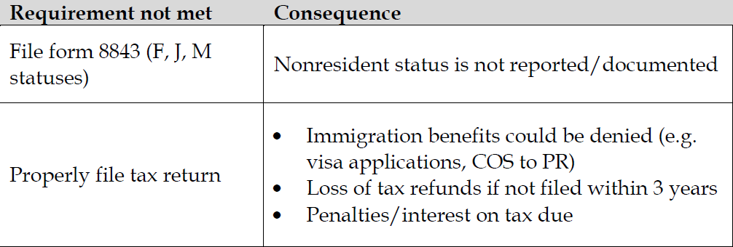
Non-resident Taxes
http://www.irs.gov/Individuals/International-Taxpayers/Foreign-Students-and-Scholars
It is an obligation to file taxes each year.

Slide 8
Non-resident Taxes
Penalties for noncompliance with the filing requirement can include:
• Future requests for change of status (especially to Permanent Resident) may be denied;
• Visa renewals at American Consulates/Embassies may be denied;
• Fines and interest will be assessed when money is owed to the IRS.
• If filed more than 3 years late, a refund will not be remitted by the IRS to the taxpayer

Slide 9
Non-resident Taxes

Slide 10
Non-resident Taxes

Slide 11
Non-resident Taxes
Non-resident from taxes ≠ non-resident for immigration or non-resident for tuition purposes.
Usually, the first five years that an F1 student is inside the United States, that student is considered non-resident for tax purposes.
If you are here longer than five years or you have been to the United States in another visa status previously, you will need to fill out a form to see if you meet the substantial presence qualification.

Slide 12
Non-resident Taxes- Basic Forms
IRS Form 8843: Statement for Exempt Individuals and Individuals With a Medical Condition
https://www.irs.gov/pub/irs-pdf/f8843.pdf
Everyone, even dependents, need to complete this form.
IRS From 1040NR : U.S. Nonresident Alien Income Tax Return
https://www.irs.gov/pub/irs-pdf/f1040nr.pdf
Complete this form as well if your worked, or received income.

Slide 13
Non-resident Taxes: Form 8843
4. Use a calendar to count the days that you were present in the U.S. You can use your I-94 to see the exact date of your arrival. Subtract any days that you were outside the country
9. Red Rocks Community College
13300 W 6th Avenue, Lakewood, CO 80228
303-914-6600
10. Linda Yazdani/Red Rocks Community College, Box 33 13300 W 6th Avenue, Lakewood, CO 80228
303-914-6416

Slide 14
Non-resident Taxes: Form 8843 Continued
Sign and Date

Slide 15
Non-resident Taxes IRS Form 1040NR (non-resident)

Slide 16
Non-resident Taxes IRS Form 1040NR (non-resident) Continued

Slide 17
Non-resident Taxes Filing Dates
April 18, 2022

Slide 18
Non-resident Taxes
If you do not have to file a 1040NR or other tax return,
send your completed 8843 to
Department of the Treasury, Internal Revenue Service Center
Austin, Texas 73301-0215

Slide 19
Non-resident Taxes
If you have worked and need to file the 1040NR.
Send the 8843 along with your completed 1040NR and any payment necessary to:
If you are not enclosing a payment, mail Form 1040-NR to:
Department of the Treasury Internal Revenue Service Austin, TX 73301-0215 U.S.A.
If enclosing a payment, mail Form 1040-NR to: Internal Revenue Service P.O. Box 1303 Charlotte, NC 28201-1303 U.S.A
* Always check on the IRS website to ensure the address is correct.

Slide 20
Non-resident Taxes
If you are not sure or are not comfortable filling out these forms by yourself, don’t worry. You are not alone.
Help is available.

Slide 21
Non-resident Taxes
There are tax assistance services who can help you prepare your taxes.
CAUTION!
Many popular tax software programs and services do not do non-resident tax.
H&R Block
Turbo Tax
Free resident tax services

Slide 22
Non-resident Taxes
Sprintax: https://www.sprintax.com/
Glacier Tax Prep: https://www.glaciertax.com/index
Thomas Rueters: https://tax.thomsonreuters.com/
* These links are given as resources not endorsements.

